Slide 1
MEMORY ORGANIZATION
Memory Hierarchy
Main Memory
Auxiliary Memory
Associative Memory
Cache Memory
Virtual Memory
Memory Management Hardware

Slide 2
Cache Memory
Locality of reference
Why cache is used??
Reduce access time, execution time…
Basic operation of cache…
Hit,miss,Hit ratio--- performance of cache memory
Mapping in cache??
(Transfer data from main memory to cache memory)

Slide 3
Associative Mapping
Direct Mapping
Set-Associative Mapping
Example:
The main memory can store 32K words of 12 bits each. The cache is capable of storing 512 of these words at any given time.
The CPU communicates with both memo­ries. It first sends a 15-bit address to cache. If there is a hit, the CPU accepts the 12-bit data from cache. If there is a miss, the CPU reads the word from main memory and the word is then transferred to cache.

Slide 4
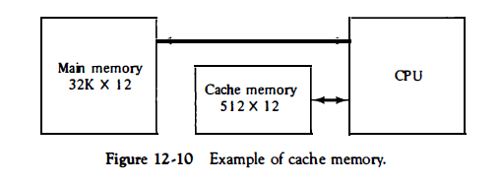

Slide 5
Associative Mapping
Associative memory is used in associative mapping.
The associative memory stores both the address and content (data) of the memory word.
Permits any location in cache to store any word from main memory.
A CPU address of 15 bits is placed in the argument register and the associative memory is searched for a matching address

Slide 6
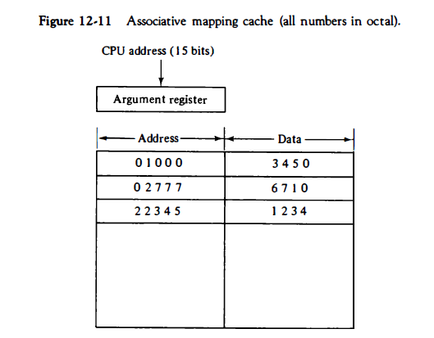

Slide 7
Direct Mapping
The CPU address of 15 bits is divided into two fields. The nine least significant bits constitute the index field and the remaining six bits form the tag field.
There are 2^K words in cache memory and 2^n words in main memory.
The n-bit memory address is divided into two fields:
k bits for the index field and n - k bits for the tag field. The direct mapping cache organization uses the n-bit address to access the main memory and the k-bit index to access the cache.

Slide 8
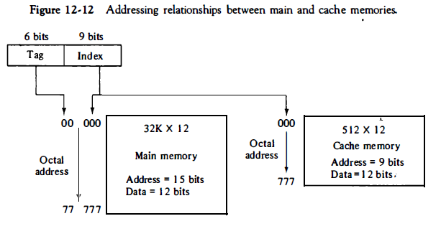

Slide 9
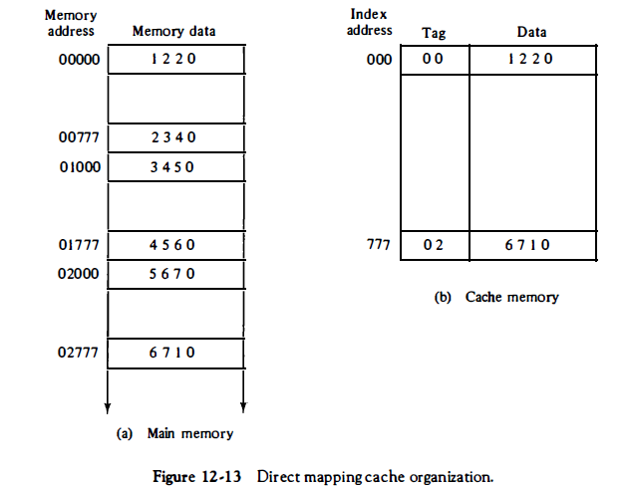

Slide 10
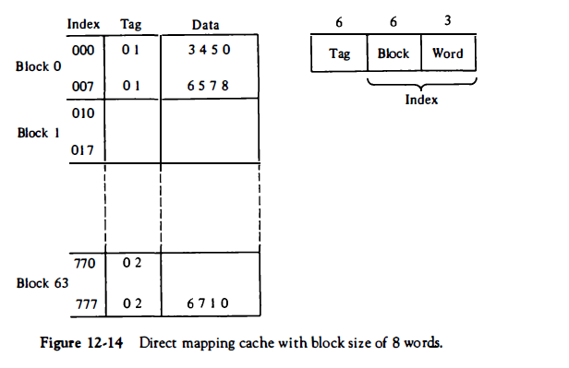

Slide 11
Set Associative Mapping
Disadvantage of direct mapping ?
Two words with the same index in their address but with different tag values cannot reside in cache memory at the same time.
Set associative mapping is improvement over direct mapping
Each word of cache can store two or more words of memory under the same index address
Each data word is stored together with its tag and the number of tag-data items in one word of cache is said to form a set.

Slide 12
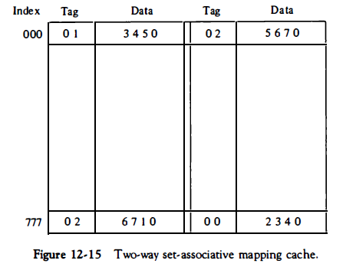

Slide 13
Why name set-associative?
Disadvantage?
Advantage?
What happen when miss occurs in set-associative mapping?
Page –replacement algorithms
Random replacement, FIFO, LRU

Slide 14
How many 128 x 8 RAM chips are needed to provide a memory capacity or 2048 bytes?
16chips
How many lines of the address bus must be used to access 2048 bytes of memory? How many of these lines will be common 10 all chips?
11 address lines
7 lines to address each chip

Slide 15
Writing into cache Memory
Read operation--- Main Memory is not involved
Write through method
-------Where used? Advantage of this method?
-------Most recent updated data---DMA
Write back---only cache is updated
When updated?
Initialization of cache memory
Valid bit

